Slide 1
From Logic to Gates
Two-level logic: ANDs followed by ORs
Example: Y = ABC + ABC + ABC

Slide 2
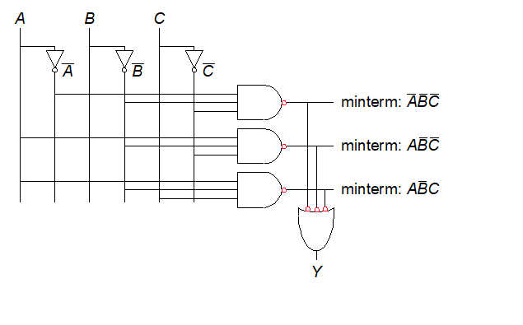
From Logic to Gates
Two-level logic: ANDs followed by ORs
Can be transformed in a NAND-NAND network

Slide 3
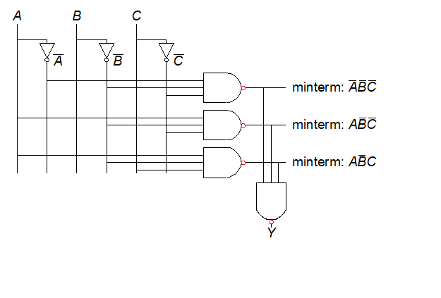
From Logic to Gates
Two-level logic: ANDs followed by ORs
Can be transformed in a NAND-NAND network

Slide 4
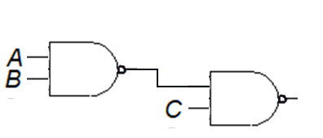

Caveat
NAND and NOR ports are NOT associative:
≠
ABC ≠ ABC

Slide 5
Circuit Schematics Rules
Inputs on the left (or top)
Outputs on right (or bottom)
Gates flow from left to right
Straight wires are best

Slide 6
Circuit Schematic Rules (cont.)
Wires always connect at a T junction
A dot where wires cross indicates a connection between the wires
Wires crossing without a dot make no connection

Slide 7
Multiple-Output Circuits
Example: Priority Circuit
Output asserted
corresponding to most
significant TRUE input

Slide 8
Multiple-Output Circuits
Example: Priority Circuit
Output asserted
corresponding to most
significant TRUE input

Slide 9
Priority Circuit Hardware

Slide 10
Don’t Cares

Slide 11
Contention: X
Contention: circuit tries to drive output to 1 and 0
Actual value somewhere in between
Could be 0, 1, or in forbidden zone
Might change with voltage, temperature, time, noise
Often causes excessive power dissipation
Warnings:
Contention usually indicates a bug.
X is used for “don’t care” and contention - look at the context to tell them apart.

Slide 12
Floating: Z
Floating, high impedance, open, high Z
Floating output might be 0, 1, or somewhere in between
A voltmeter won’t indicate whether a node is floating
Tristate Buffer

Slide 13
Tristate Busses
Floating nodes are used in tristate busses
Many different drivers
Exactly one is active at once

Slide 14
Karnaugh Maps (K-Maps)
Boolean expressions can be minimized by combining terms
K-maps minimize equations graphically
PA + PA = P

Slide 15
K-Map
Circle 1’s in adjacent squares
In Boolean expression, include only literals whose true and complement form are not in the circle
Y = AB

Slide 16
3-Input K-Map

Slide 17
3-Input K-Map (Do it)

Slide 18
3-Input K-Map (Done)
0 1 0 0
0 1 1 0
Y=A’B+BC
0
0

Slide 19
K-Map Definitions
Complement: variable with a bar over it
A, B, C
Literal: variable or its complement
A, A, B, B, C, C
Implicant: product of literals
ABC, AC, BC
Prime implicant: implicant corresponding to the largest circle in a K-map

Slide 20
K-Map Rules
Every 1 must be circled at least once
Each circle must span a power of 2 (i.e. 1, 2, 4) squares in each direction
Each circle must be as large as possible
A circle may wrap around the edges
A “don't care” (X) is circled only if it helps minimize the equation

Slide 21
4-Input K-Map (Do it)

Slide 22
4-Input K-Map

Slide 23
4-Input K-Map (Done)

Slide 24
K-Maps with Don’t Cares

Slide 25
K-Maps with Don’t Cares

Slide 26
K-Maps with Don’t Cares (Done)
Notes:
Fine lezione 3

Slide 27
Duality
K-Maps can be used also to create a minimal POS form:
Collects 0 instead of 1
Each square represents a maxterm
Each covering represents a SUM

Slide 28
Duality
K-Maps can be used also to create a minimal POS form:
Collects 0 instead of 1
Each square represents a maxterm
Each covering represents a SUM

Slide 29
4-Input Maxterms
A+B+C+D A+B’+C+D A’+B’+C+D A’+B+C+D
A+B+C+D’ A+B’+C+D’ A’+B’+C+D’ A’+B+C+D’
A+B+C’+D’ A+B’+C’+D’ A’+B’+C’+D’ A’+B+C’+D’
A+B+C’+D A+B’+C’+D A’+B’+C’+D A’+B+C’+D

Slide 30
4-Input K-Map (Do it again)
1 0 0 1
0 1 0 1
1 1 0 0
1 1 0 1
Y=(A’+B’)(B’+C+D)(A’+C’+D’)(A+B+C+D’)

Slide 31
K-Maps with Don’t Cares (Do it again)
1 0 X 1
0 X X 1
1 1 X X
1 1 X X
Y= (B’+C)(A+C+D’)

